Slide 1
Pathway for Innovation
& Technology (PIT) Overview
UNCLASSIFIED
MAY2026
DR. MATT WILLIS / DIRECTOR, ARMY FUZE
Office of the Deputy Assistant Secretary of the Army for Research & Technology
UNCLASSIFIED
LAST UPDATED: 6 AUG 2026

Slide 2
A NEW ERA OF ARMY INNOVATION
UNCLASSIFIED
PATHWAY FOR INNOVATION & TECHNOLOGY (PIT) OVERVIEW
“We are amidst a transformation that transcends all others. It will be measured in months, not years or decades. It will be disruptive, chaotic, and uncomfortable. But every moment we lose mission-focus, we cede ground to our adversaries. Every advance they make increases risk to everything we hold dear.”
The Army is a warfighter and innovation engine that engages as:
An Innovation Partner
A Provider of Public Capital
To Buy-Down Technical Risk
A Scalable Buyer
Secretary of the Army
HON Dan Driscoll
UNCLASSIFIED

Slide 3
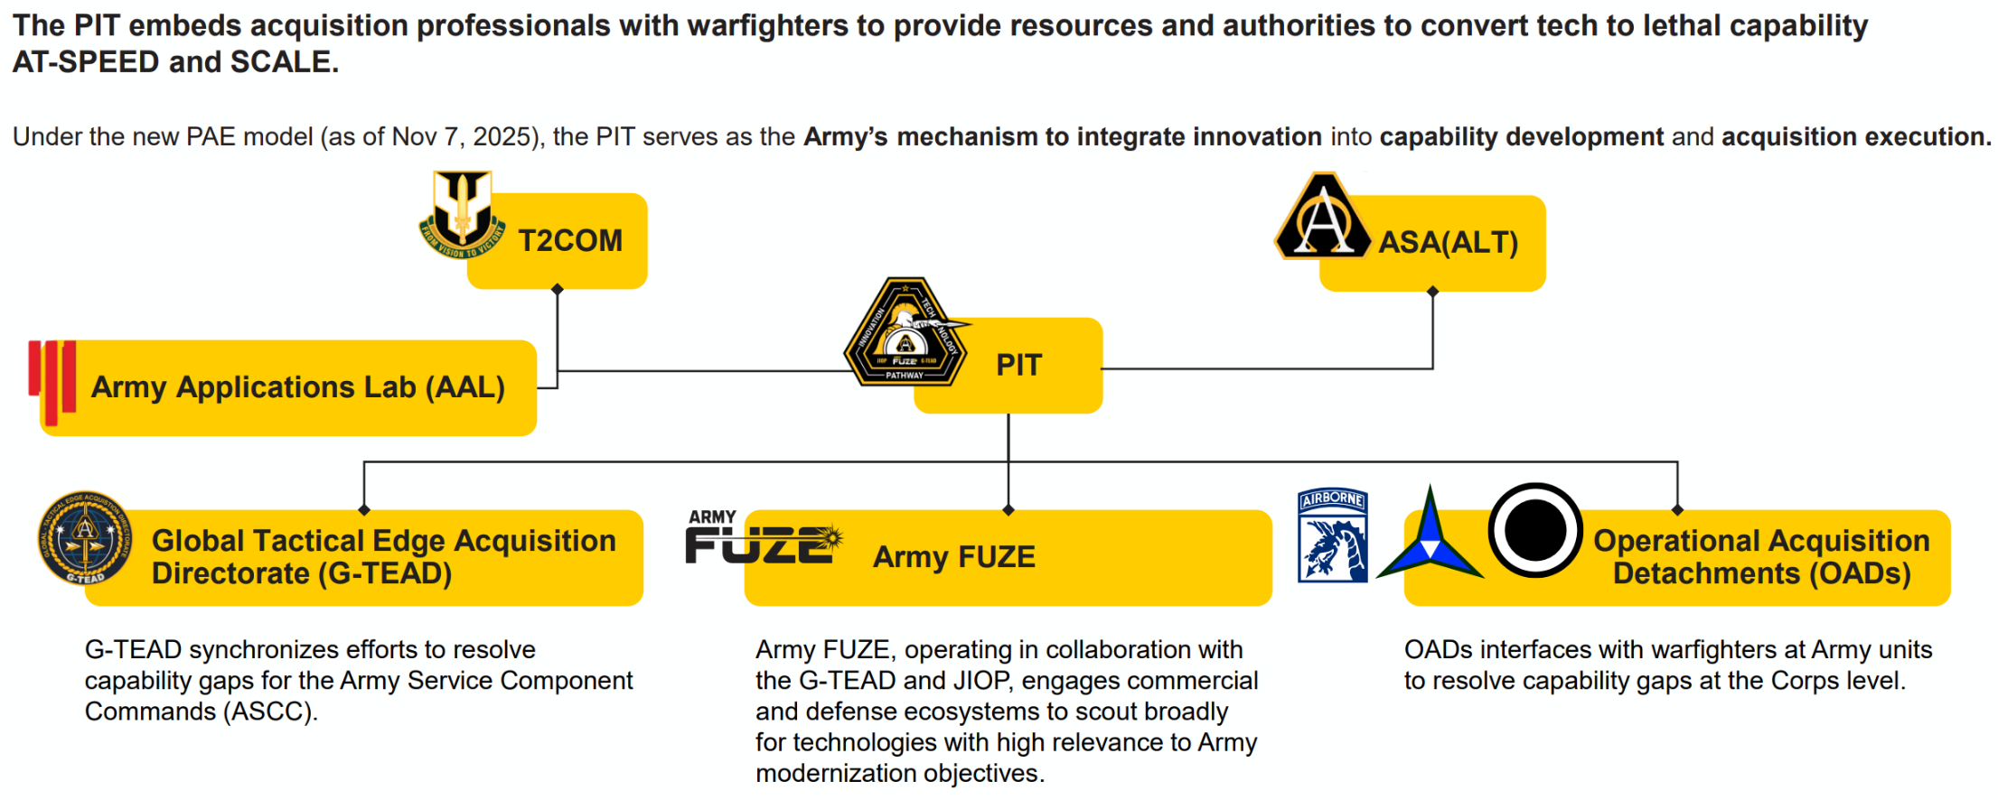
PATHWAY FOR INNOVATION AND TECHNOLOGY (PIT)
PATHWAY FOR INNOVATION & TECHNOLOGY (PIT) OVERVIEW
UNCLASSIFIED
The PIT embeds acquisition professionals with warfighters to provide resources and authorities to convert tech to lethal capability AT-SPEED and SCALE.
Under the new PAE model (as of Nov 7, 2025), the PIT serves as the Army’s mechanism to integrate innovation into capability development and acquisition execution.
UNCLASSIFIED

Slide 4




PIT PRIORITIES
UNCLASSIFIED
PATHWAY FOR INNOVATION & TECHNOLOGY (PIT) OVERVIEW
Autonomous Breaching
Tactical Logistics
Expeditionary Power
Arctic Operations
Control vehicles with armored systems
Sustain air and ground obscuration for mission duration
Enable integrated networks to streamline breaching operations
Deliver munitions autonomously
Equip mounted volcano capabilities to operational units
Accelerate protected lane proofing and marking processes
Automate distant resupply and minimize Soldier exposure
Empower brigade level logistics system modernization
Deploy unmanned casualty evacuation platforms
Deliver autonomous resupply capabilities for distributed operations
Mobile Brigade Combat Teams (MBCT) independently
Design scalable energy distribution networks without lift heavy solutions
Lower the physical and auditory signature while reducing reliance on fuel resupply
Standardize energy forecasting tools across units and echelons
Develop lightweight systems to enable over snow mobility for fire support
Equip MBCTs with the ability to recover air dropped supplies autonomously
Provide solutions for hot food, potable water creation, and mobile arctic sustainment systems
UNCLASSIFIED

Slide 5
ARMY FUZE OVERVIEW
UNCLASSIFIED
ARMY FUZE PORTFOLIO OVERVIEW
Mission
Clear Demand Signals
Accelerate the transition of innovative capabilities to the field by connecting programs, scaling impact, and reshaping acquisition through a unified, Soldier-centric approach.
What the Army needs, how it needs it, and when
VC-Aligned Principles
What We Do
Fast prototype iterations enabled by expedited contracting
Unify Army xTech, SBIR|STTR, TMI, and ManTech into an integrated enterprise to identify emerging solutions, invest non-dilutive capital, and advance technologies with mission value and commercial scalability.
Reduced Risk
Multiple touchpoints to clearly communicate opportunities and risks of business and technology use cases
Transparent Engagement
Army investments will be directly tied to real capability needs and demand signals
UNCLASSIFIED

Slide 6





FUZE PORTFOLIO
ARMY FUZE PORTFOLIO OVERVIEW
UNCLASSIFIED
Venture
Equivalent
Pre-Seed
Seed
Series A/B
Growth/Series C
xTech
SBIR|STTR
TMI
ManTech
Army’s Front Door to Innovation
Reducing Barriers to Dual-Use Entry
Minimum Viable Prototype
Acceleration
Manufacturing at Scale and Speed
3-5 pg. White Paper / Live Pitch
7–15-pg. proposal, or Prize Competition
Army Stakeholder Originated
Army Stakeholder Originated
Entry
Investments
$5-$500k Non-Dilutive Cash Prizes
$300k-2M+ contracts
$2-$15M+ contracts
$2-$25M
Transition to PAE Budgets
Solicitations
15+ Competitons Annually
Monthly
1x Call for Proposals, Annually
1x Call for Proposals, Annually
Annual Budget
$5M
$306M SBIR / $43M STTR
$250M
$67M
Objective: Transition or Fielding
Integration into
PAE programs, procurement, etc.
Avg. Timespan
4-8 Months
6-18+ Months
12-24 Months
2-3 Years
Purpose
Army Open Door
Concept to Prototype
Concept to Prototype
Mature Prototype
Mature Manufacturing Processes
UNCLASSIFIED

Slide 7

ARMY FUZE: FROM CONCEPT TO CAPABILITY
UNCLASSIFIED
ARMY FUZE PORTFOLIO OVERVIEW
Army FUZE Potential Funding Source(s)
Army FUZE Technology Investments
xTech
(Prize Competitions)
xTech + SBIR|STTR
(Open Topics)
SBIR|STTR
(Feasibility Studies))
SBIR|STTR + TMI
(Prototype Contracts)
SBIR|STTR + TMI + ManTech
(Transition Readiness))
ManTech + TMI + PAE + DIU
(Transition Planning)
Outside FUZE
Transition
to PAE Budgets
Market Research & Tech Scouting
Competitions used to connect startups, academia, and non-traditionals to Army gaps.
Solution Sourcing
Challenges, open topics, and solicitations used to screen and source promising solutions.
Feasibility and Concept Validation
Small businesses and research teams partner with labs to validate feasibility.
Prototype Development
Companies develop working prototypes with labs and SMEs.
Maturation
& Scaling
TMI funds relevance, ManTech enables scale.
Transition Pathway Identification
Commitment secured from PAEs/PMs (transition intent).
End-State: Transition
or Fielding
Integration into PAE programs, procurement, etc.
Deal Size
$5k to $250k
$10k to $250k
$100k to $500k
$1M to $20M
$5M to $35M
$5M to $50M+
$20M+
Soldier Touchpoints
Private Capital Ecosystem
Pre-Seed
Angels
Family & Friends
Pre-Seed
Angels
Pre-Seed/Seed
Angels
Early-Stage VCs
Seed, Series A/B
Venture Capital
Series A/B/C
Venture Capital
Venture Debt
Series C+, Growth
Venture Capital
Private Equity
Growth
Private Equity
Army FUZE accelerates the transition of innovative capabilities to the field by connecting programs, scaling impact, and reshaping acquisition through a unified, Soldier-centric approach, with $750+ M of non-dilutive annual R&D funding.
*TRLs increase across the entire ecosystem, but no single program takes a solution from TRL 1 through 9.
Instead, the FUZE ecosystem together delivers end-to-end TRL progression, with deliberate touchpoints and handoffs.
UNCLASSIFIED

Slide 8
IMPROVING PARTNERSHIP WITH NONTRADITIONAL INNOVATORS
UNCLASSIFIED
ARMY FUZE PORTFOLIO OVERVIEW
Respond promptly and transparently to create a positive participant experience.
Release Army SBIR|STTR topics monthly with predicable cadence of entry points for participants.
Partner with companies who can succeed in commercial industry as well as with the government.
Expedite the contracting experience through the FUZE Contracting Center.
Improve access to Army personnel, technical challenges, and data while minimizing restrictions.
Facilitate partnerships and transition into Army programs of record and/or further funding beyond the programs.
UNCLASSIFIED

Slide 9
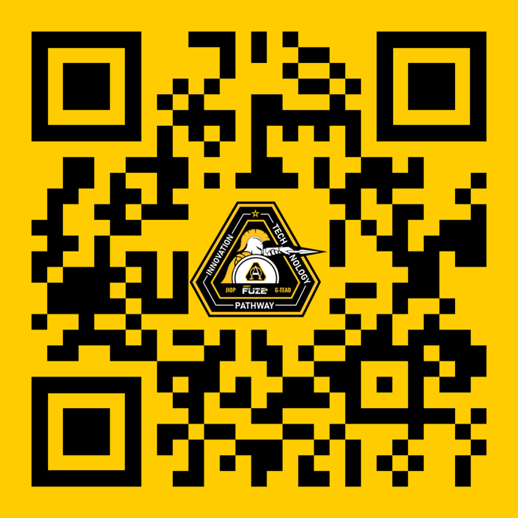
Working with the PIT
UNCLASSIFIED
pit.army.mil
ArmyPIT
@USARMYPIT
UNCLASSIFIED

Slide 10
UNCLASSIFIED
Questions?
UNCLASSIFIED

